Slide 1
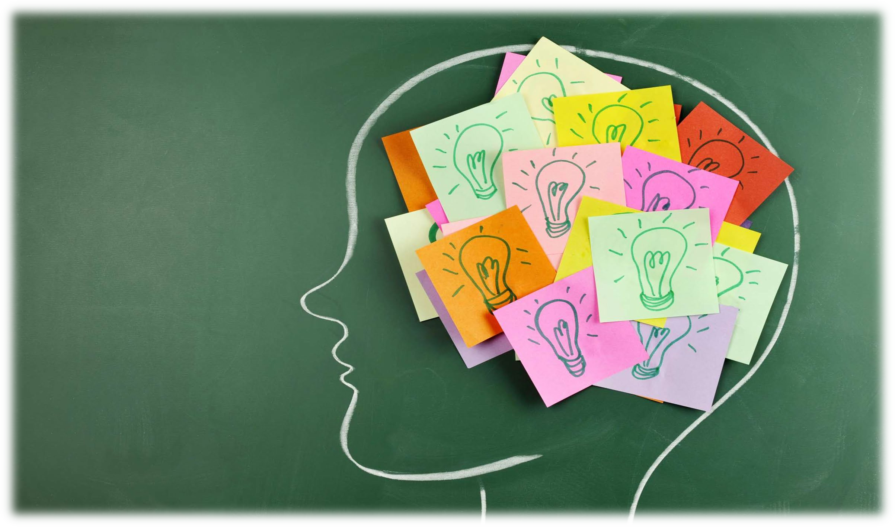
IMPROVING MY MEMORY SKILLS - 2022
BY
MR SIR AYI

Slide 2
This workshop is about seven ways to improve your memory skills

Slide 3
Common instances where a good memory is important:
Are you often unable to remember an important fact or figure?
Do you forget people’s names at the worst moments?
Are you ever asked a question, and you should know an answer, but you struggle to form an intelligent reply?

Slide 4
The basis for a good memory is a healthy mind and body.
KEY ISSUES | SOLUTION
Eat well | Make sure key vitamins are in your diet. Key vitamins would include eating fruit atleast 3 times a week.
Drink plenty of water | Most students are dehydrated and do not even know it. When you don’t drink enough water, your body and mind become weak and tired. Water makes red blood cells more effective and gives you more energy.
Get enough sleep | During sleep, your brain recharges itself.
Manage stress effectively | Use physical relaxation technique such as jogging, yoga etc.
Do not smoke and drink | Limit caffein and alcohol. Excessive alcohol can seriously affect your short-term memory. Get enough exercise.
TAKE CARE OF YOUR HEALTH

Slide 5
Mnemonics are simple-memory improving techniques that you connect everyday, easy-to-remember words and ideas to information you want to remember. Later, by recalling these everyday words, you can also recall what you wanted to remember.
USE MNEMONICS TECHNIQUES
MiND MAPING
The following mnemonics techniques can be useful to improve your memory:
The alphabet technique
The journey system technique
The roman room system technique

Slide 6
This technique works well for lists of more than 9 or 10 items.
With this system, instead of finding a word that rhymes with the number, you associate the things you want to remember with a particular letter of the alphabet from A to Z.
This is an efficient way to remember an ordered list of up to 26 items.
See example below:
THE ALPHABET TECHNIQUE

Slide 7
This system is used by associating information with landmarks on a journey that you know well.
example, the route you use from home or residence to school; the route you use to get to the front door when you get up every morning.
Once you are familiar with the technique, you may be able to create imaginary journeys that fix in your mind and transform these journeys into your everyday school work.
Example of school work, if you are doing calculations, it is important to know the formula and elements that go onto it. The formula is a starting point of your journey where you imagine your journey before you can begin with it.
THE JOURNEY SYSTEM TECHNIQUE
Same applies with calculations, once you start with the formula, automatically know the steps that you need to go through before the final answer. E.g if you are calculating break-even point or analysis, you will know the elements that included in the formula.
▪

Slide 8
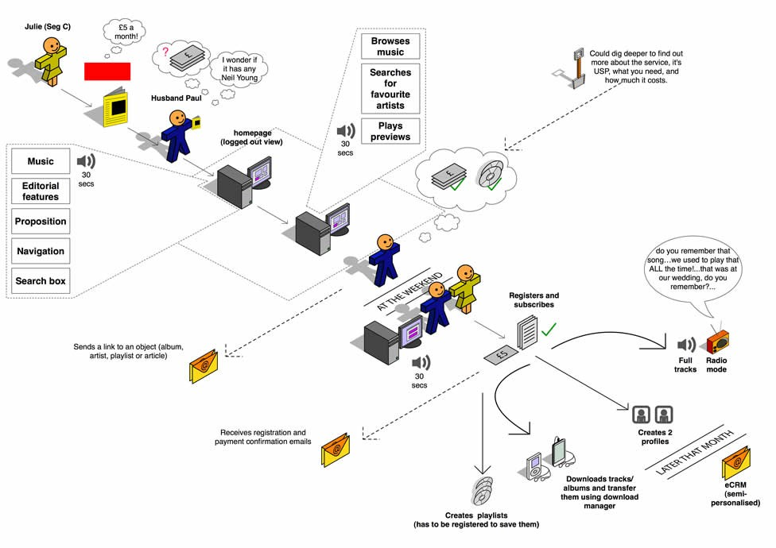
THE JOURNEY SYSTEM TECHNIQUE

Slide 9
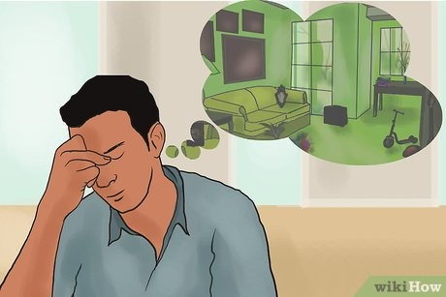
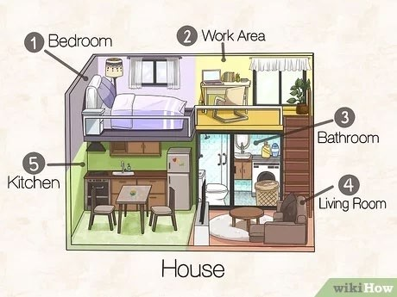
This technique uses location to stimulate your memory.
To use this technique, imagine a room that you know well, such as your sitting room, bedroom, office or classroom.
Example, you may want to remember a list of World War I war poets:
Rupert Brooke, G.K. Chesterton, Walter de la Mare, Robert Graves, Rudyard Kipling, Wilfred Owen, Siegfried Sassoon, W.B. Yates.
THE ROMAN ROOM SYSTEM TECHNIQUE

Slide 10
Have you ever studied a subject or brainstormed an idea, only to find yourself with pages of information, but no clear view of how it fits together?
This is where Mind Mapping can help.
Mind Mapping is a useful technique that supports learning, improves information recording, shows how different facts and ideas are related, and enhances creative problem solving.
Mind Maps are useful for:
Brainstorming
MIND MAPPING TECHNIQUE
Summarizing information
Taking notes
Consolidating information from different sources
Thinking through complex problems
Presenting information clearly
Studying and memorizing information

Slide 11
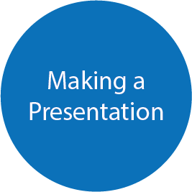
5 STEPS OF MIND MAPPING TECHNIQUE
Step 1: Write the title of the subject or project that you're exploring in the center of a page and draw a circle around it, as shown in the example below:

Slide 12
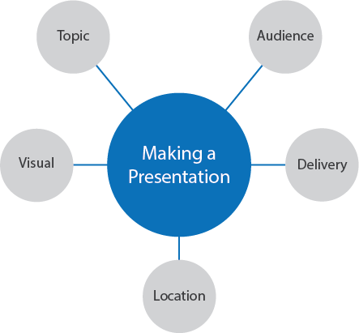
Step 2: Draw lines out from the circle as you think of subheadings of the
topic or important facts or tasks that relate to your subject. Label these lines with your subheadings. See example below:
5 STEPS OF MIND MAPPING TECHNIQUE

Slide 13
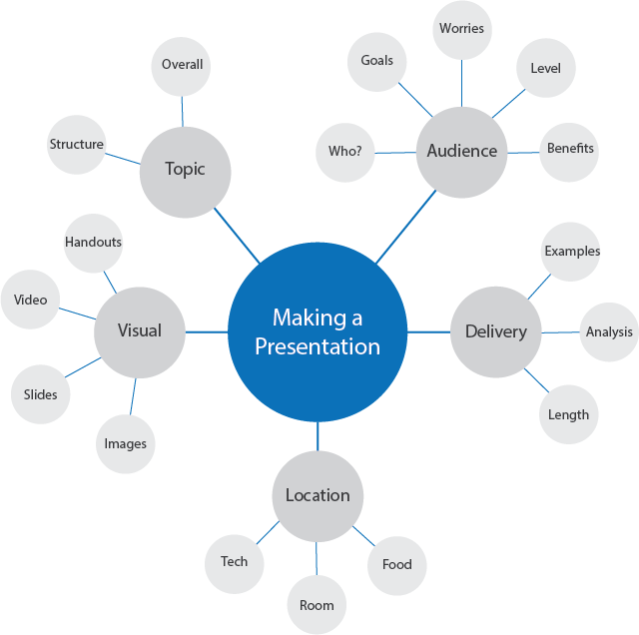
5 STEPS OF MIND MAPPING TECHNIQUE
Step 3. Dive deeper into the subject to uncover the next level of information, Then, link these to the relevant subheadings. See example below:

Slide 14
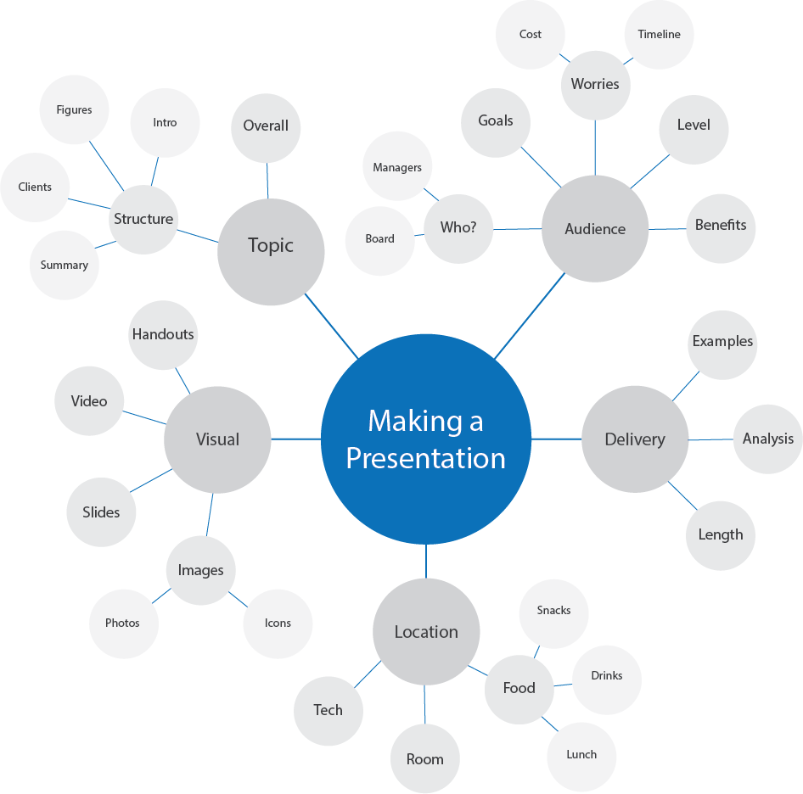
5 STEPS OF MIND MAPPING TECHNIQUE
Step 4: Repeat the process for the next level of facts, tasks and ideas. Draw lines out from the appropriate headings and label them, as shown in the example below.

Slide 15
5 STEPS OF MIND MAPPING TECHNIQUE
Step 5: As you discover new information or think of additional tasks, add them to your Mind Map in the appropriate places.

Slide 16
As with other parts of your body, your mind needs exercise. You can exercise your brain by using it in different ways, on a regular basis.
Try the following:
Learn a new skill or start a hobby – Find activities that build skills you don't normally use in your daily life. For example, if you work with numbers all day, develop your creative side with art classes or photography.
Use visualisation on a regular basis – Since much of memory involves associating and recalling images, it's important to build this skill. Get plenty of practice with this.
Keep active socially – When you communicate and interact with people, you have to be alert. This helps keep your brain strong and alive.
CHALLENGE YOUR BRAIN
Focus on the important things – You can't possibly remember everything, so make sure you give your brain important things to do – and don't overload it with "waste." The "garbage in, garbage out" philosophy works well here.

Slide 17
THANK YOU

