Slide 1
TIME MANAGEMENT BY MR S SIRAYI (ACADEMIC ADVISOR AND LECTURER)

Slide 2
Workshop content
After learning time management, students should be able to:
Identify distractions and solutions
Get organized with their work
To work with 5-step plan
Create a time schedule
Apply the promodoro technique to their studies

Slide 3
Distractions vs Solutions
DISTRACTIONS | SOLUTIONS
Random web surfing | When doing school work or studying: Unplug your internet cable Disable your Wi-Fi
Playing video games | To avoid temptations: Study at the public library Study at your university If it is a cellphone game, uninstall it
Cellphone distraction | To avoid being distracted by your phone during school work: Keep yourself logged out of social media, and switch to airplane mode
Notes:
Good introduction

Slide 4
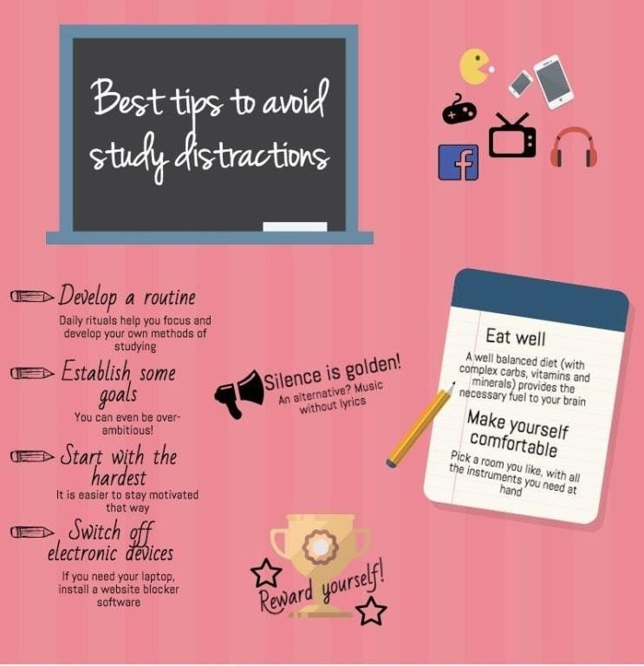
Golden tips to avoid distractions
Notes:
Good introduction

Slide 5
Getting organised with your school work
Most students do not really think about how their workspace impacts productivity
Optimising your dedicated workspace can boost your study time while keeping you informed about tasks and deadlines
The following exercises might be useful to you:
As a student, you are more likely to move regularly from your place of residence to the university and back, therefore, it is necessary to have a simple system that allows you to pack within seconds while it is easy to maintain
It is advisable to keep a shelf in your room with study materials, where you put files, books, pens, notebooks, etc. Use a box for each course, where you put notes, photocopies, handouts, journal articles, etc.
Pin up a weekly timetable where you see it every day, such as the door. In this timetable, mark your exams, lecture projects deadlines and other social events

Slide 6
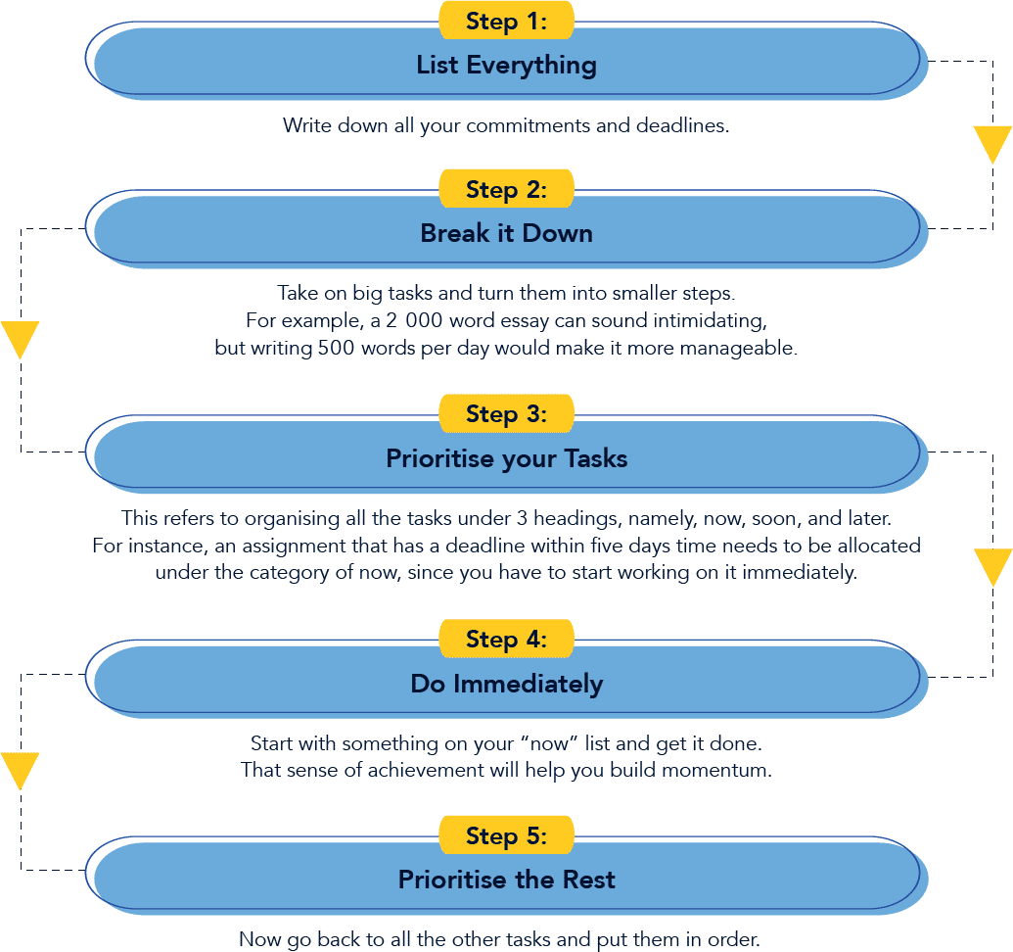
The 5-step plan

Slide 7
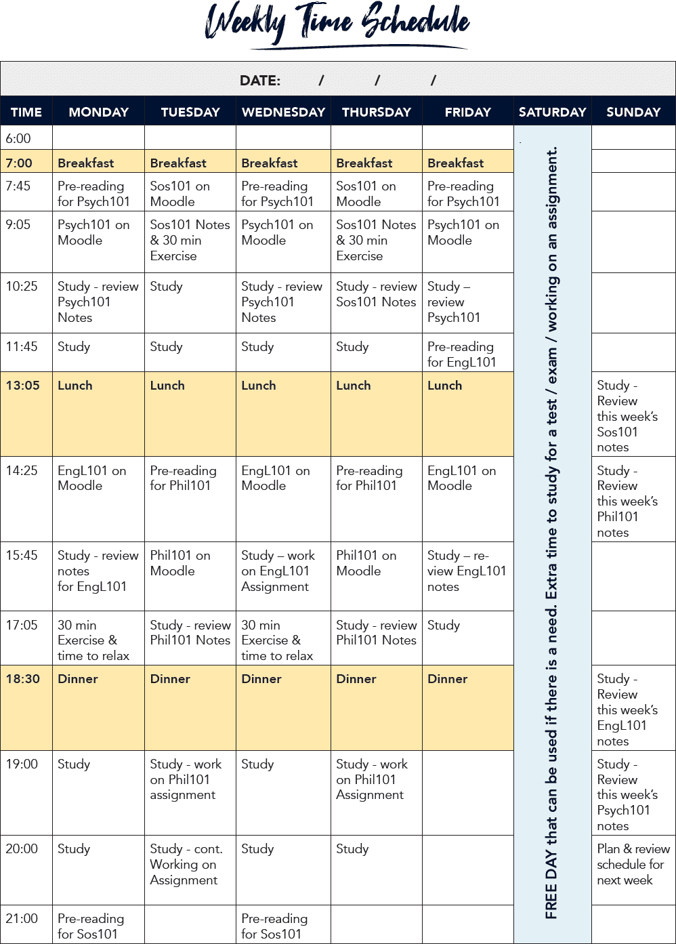
Creating weekly study time schedule
Apply the previous 5-step plan to begin scheduling your own time
Below is an example of what a university work schedule could look like when you plan for all of your modules and calculate sufficient time for all your academic activities:

Slide 8
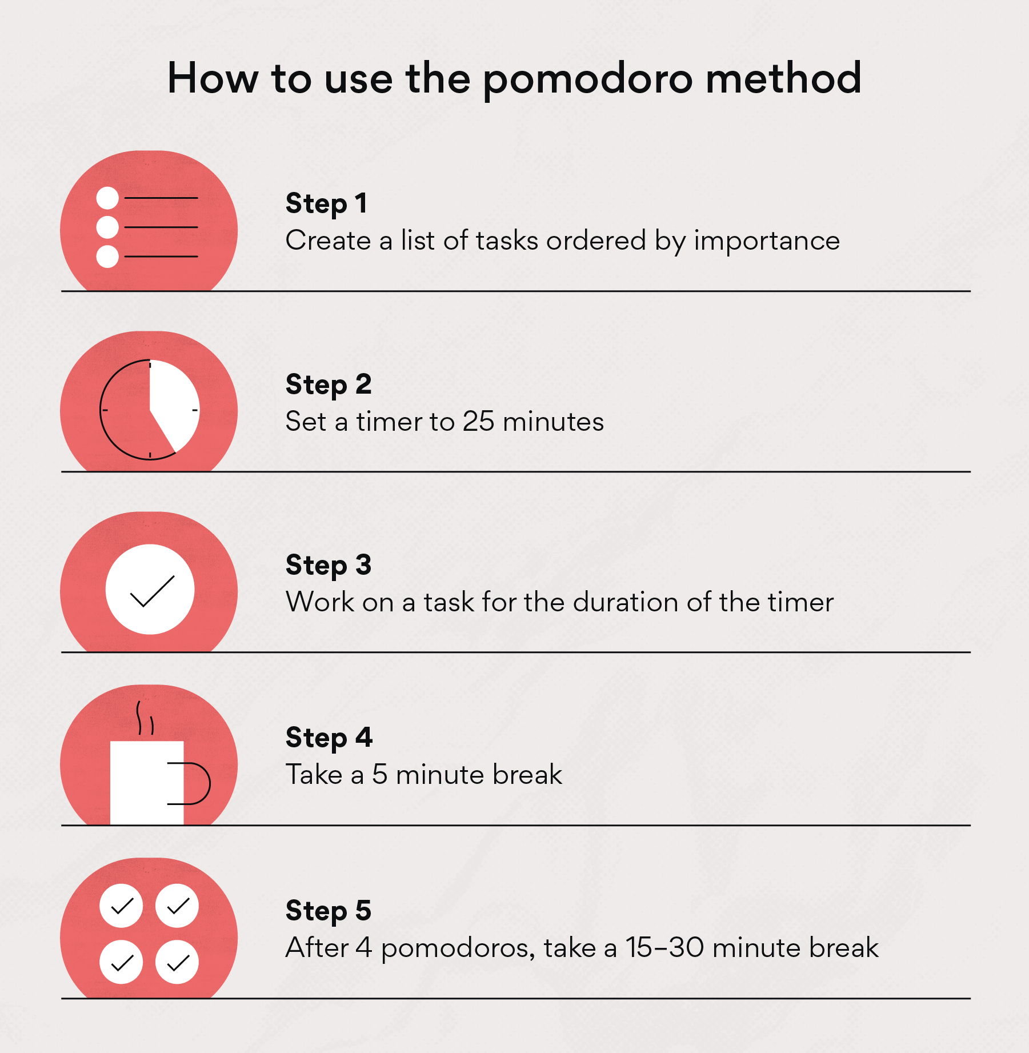
Apply promodoro technique
The Pomodoro Technique is a time management technique developed by Francesco Cirillo in the late 1980s
The technique uses a timer to break down work into intervals, traditionally 25 minutes in length, separated by short breaks such as 10 minutes.

Slide 9
END OF PRESENTATIONS Academic Advisor contact information: Mr Sirayi Siyabonga.Sirayi@mandela.ac.za dept: Business Management South campus

